Slide 1
Organizational Design and Structure

Slide 2
What is an Organization?
An organization is a system of consciously coordinated activities or forces of two or more persons
An organization is an open system, meaning that its survival and operation depends on constant interaction with its environment
LECTURE 13: Open System Theory ∙ Design ∙ Configurations
Notes:
1

Slide 3
What is an Organization?
Open System Theory:
Open: Organizations are open to, and influenced by, their environments
System: Movement in one part leads to predictable movement in another
Organizations import resources, transform it into a product characteristic of organizational processes, export the product, and re-energize from sources in the environment
LECTURE 13: Open System Theory ∙ Design ∙ Configurations

Slide 4
What is an Organization?
LECTURE 13: Open System Theory ∙ Design ∙ Configurations

Slide 5
Organizational Design
Organizational structure is the vertical and horizontal configuration of departments, authority, and jobs within an organization
Organizational design is the process of constructing and adjusting an organization’s structure to achieve its business strategy and goals relative to its environment
LECTURE 13: Open System Theory ∙ Design ∙ Configurations
Notes:
1

Slide 6
Organizational Design
By differentiating and integrating both tasks and roles, organizational structure determines organizational process (activities that transform input into output) by clarifying :
Formal lines of authority and responsibility
Formal systems of communication, coordination, and integration
LECTURE 13: Open System Theory ∙ Design ∙ Configurations

Slide 7
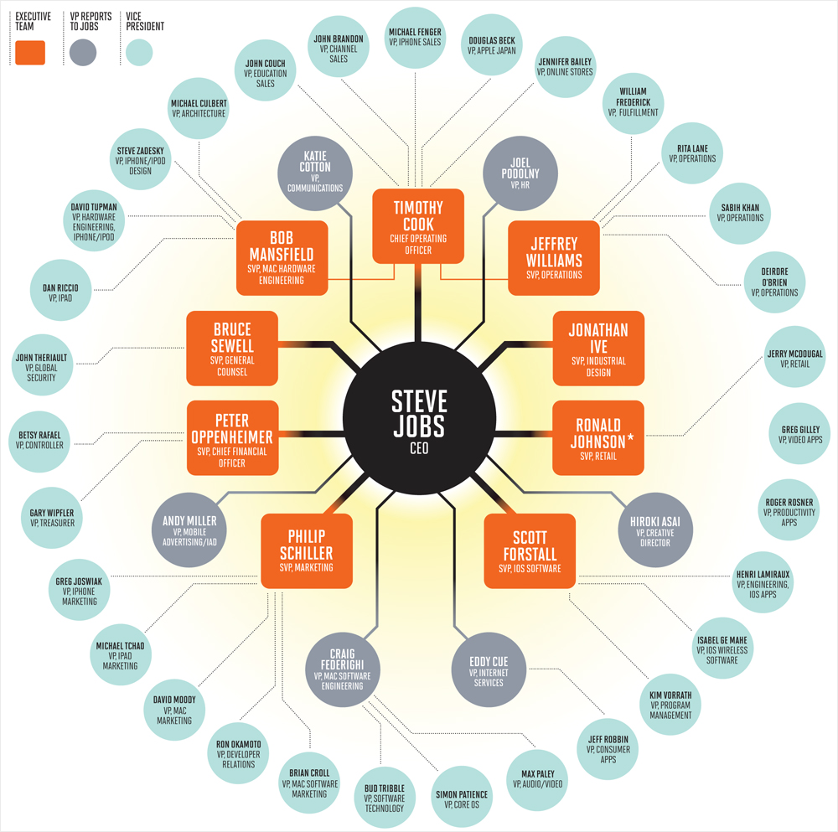
Organization Design
LECTURE 13: Open System Theory ∙ Design ∙ Configurations

Slide 8
Organization Design
LECTURE 13: Open System Theory ∙ Design ∙ Configurations

Slide 9
Differentiation
Differentiation is the process of breaking down organizational goals into tasks; there are three types of differentiation
Horizontal: Between organizational sub-units
Based on employee knowledge, education, and training (i.e., task specialization)
Increased specialization leads to increased departmentalization – if unique jobs may need a new department
LECTURE 13: Open System Theory ∙ Design ∙ Configurations

Slide 10
Differentiation
Vertical: Between hierarchical/authority levels
Decrease as span of control (number of subordinates a manager supervises) increases
More control, bureaucratic communication, high opportunity for promotion
Spatial: Between geographic locations NY LA
Political and legal issues also play a role in decisions to spatially differentiate
LECTURE 13: Open System Theory ∙ Design ∙ Configurations

Slide 11
Differentiation
As differentiation increases, so does complexity; as complexity increases, firms need more links to coordinate different parts
Integration is the process of linking tasks and roles together to form a structure that supports strategy and goal accomplishment
LECTURE 13: Open System Theory ∙ Design ∙ Configurations

Slide 12
Integration
Vertical linkages coordinate hierarchical tasks:
Hierarchical referrals (problem solving; delegation)
Rules/procedures (standing information)
Plans and schedules
Management information systems
Horizontal integration connects jobs
Liaison roles/integrators
Task forces or teams (new interdependent entities)
LECTURE 13: Open System Theory ∙ Design ∙ Configurations
Notes:
1

Slide 13
Organizational Design
Traditional organizational designs rely on high vertical differentiation to control workers in horizontally differentiated jobs; high specialization and standardization standard bureaucratic organization
Organized by function, division (e.g., products, services, regions, etc.), or matrix (integration of function and division, intersecting command structures) (function or divisions - leads to silos)
LECTURE 13: Open System Theory ∙ Design ∙ Configurations
Notes:
1

Slide 14
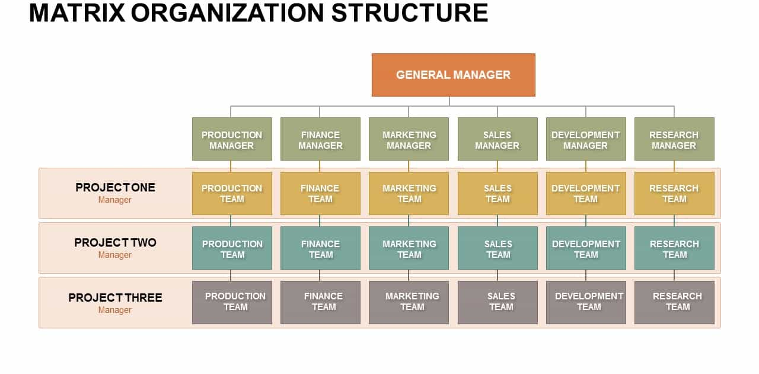
Organizational Design
LECTURE 13: Open System Theory ∙ Design ∙ Configurations
Notes:
1

Slide 15
Organizational Design
Fed up with hierarchy, many organizations shifted to a horizontal structure, which removes vertical structures (departments, authority) and instead supports teams and social interaction; complex but allows for greater agility (makes for a more nimble, flexible organization)
Organized by cross-functional teams that form and dissolve as needed; ‘processes’ that involve all the tasks and roles to fulfill a customer need…. Processes come and go as needed
LECTURE 13: Open System Theory ∙ Design ∙ Configurations
Notes:
1

Slide 16
Organizational Design
LECTURE 13: Open System Theory ∙ Design ∙ Configurations
Notes:
1

Slide 17
Organizational Design
With the rise of external services, many organizations opt for an open structure, in which they outsource many functions and rely on external collaboration; allows for rapid response to market changes
Organized as a network (outsource all processes but core function), modular (outsource entire product segments), or virtual (workers collaborating together under unified company)
LECTURE 13: Open System Theory ∙ Design ∙ Configurations
Notes:
1

Slide 18
ACTIVITY
LECTURE 13: Open System Theory ∙ Design ∙ Configurations
Notes:
1

Slide 19
Configurations
Mintzberg delineated five basic parts of every organization:
Strategic apex
Middle line
Operating core
Support staff
Technostructure
LECTURE 13: Open System Theory ∙ Design ∙ Configurations
Notes:
<number>

Slide 20
Configurations
There are five general configurations; each emphasizes one part of the organization’s parts
Simple structure: Centralized, low formalization, low vertical differentiation, heavy use of direct supervision
Machine bureaucracy: Limited horizontal decentralization, high vertical differentiation, high formalization, high standardization, technical staff have much power
LECTURE 13: Open System Theory ∙ Design ∙ Configurations

Slide 21
Configurations
Professional bureaucracy: Decentralized, vert/horiz differentiation, high standardization of professionals’ skills, staff support the operating core (professionals)
Divisionalized form: Vertical decentralization (focus on middle line), each part functions in own market, standardized output
Adhocracy: Decentralization, with support staff that link experts into project based teams
LECTURE 13: Open System Theory ∙ Design ∙ Configurations

Slide 22
Configurations
LECTURE 13: Open System Theory ∙ Design ∙ Configurations

